Slide 1
Group 4 Covid-19 Critical Care
Presentation

Slide 2

Challenge Introduction
Challenge Context:
Covid-19 Online Course
Data Types:
Students’ Demographics
Course Feedback
Course Content
Enrolments Data
Data Holder:
Lauren Johnston-Smith
Audience:
future students/holder’s colleagues
Target:
Attract potential students
Present to colleagues

Slide 3
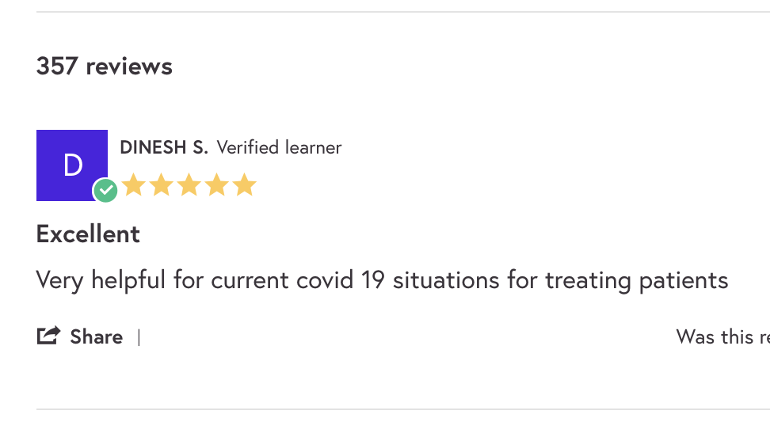

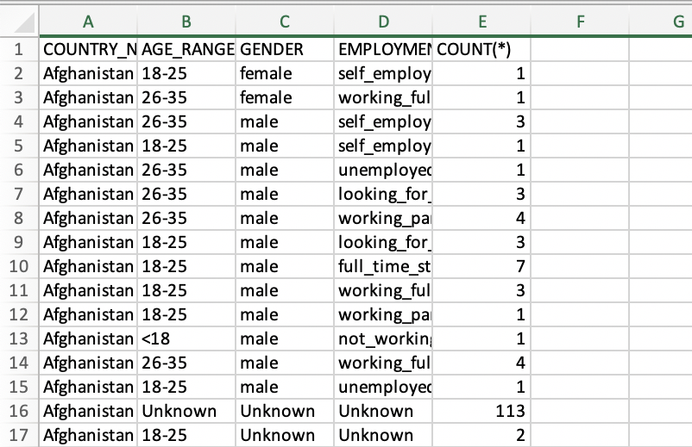
Our Data Formats
Learners’ Reviews
Course Content
Excel Spreadsheets

Slide 4


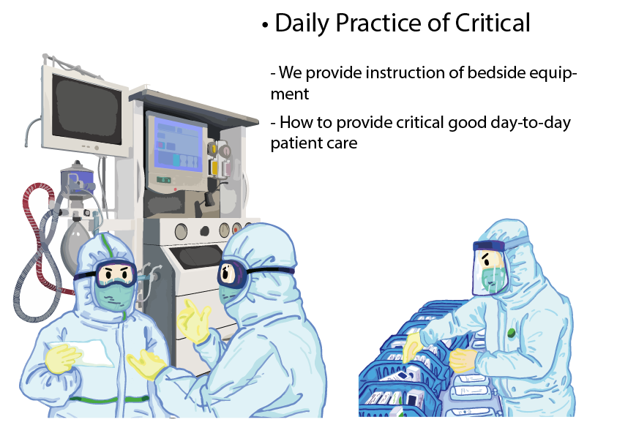



Part 1 Course Introduction—— Angie Liu

Slide 5
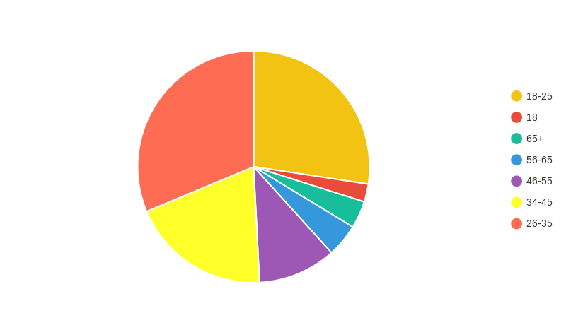

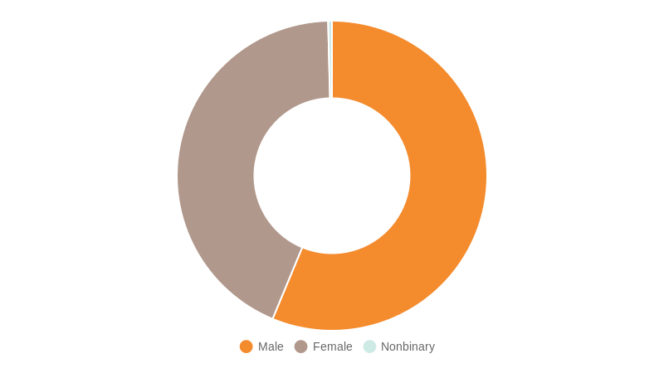
45,577 enrolled on this course
Part 2 Student Demographics—— Di Nie
18.7%
31.3%
27.4%
11.2%
42.7%
19.5%
The percentage of Student Employment status
The student age ratio
43.3%
56.2%
The student gender ratio

Slide 6
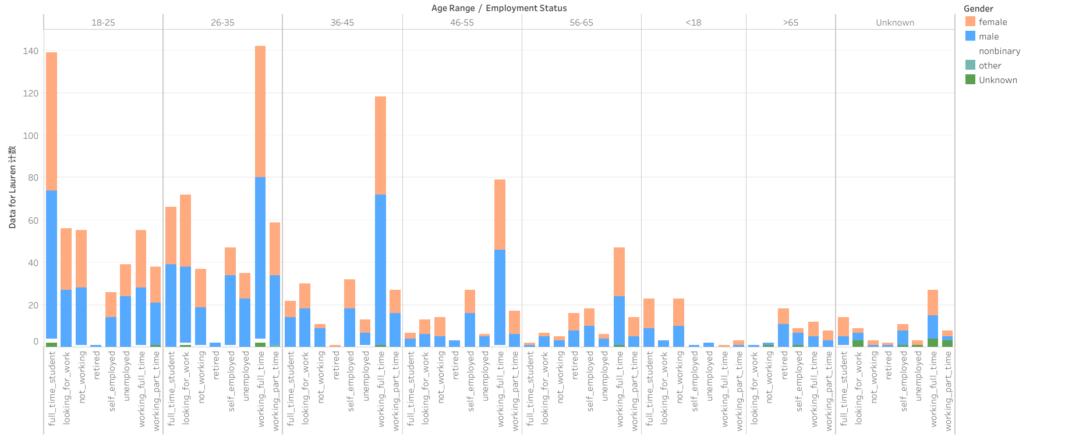
Part 2 Student Demographics—— Di Nie
The working status and gender of students of different ages
Statistically our main group of students are full-time workers aged 26 - 35 and full-time students aged 18 - 25
In terms of gender distribution, the difference is small.

Slide 7
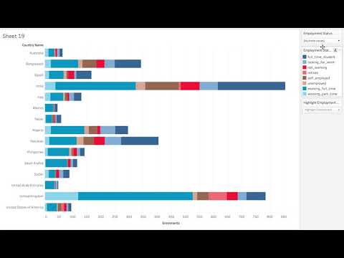
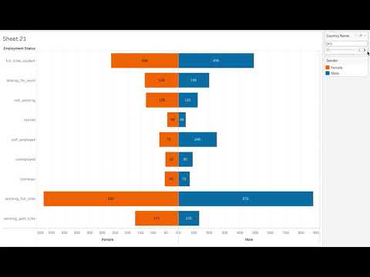
Part 2 Student Demographics—— Xi Pang
A bar chart shows the distribution of students’ employment status for each country
A chart shows the distribution of students’ gender for each country

Slide 8
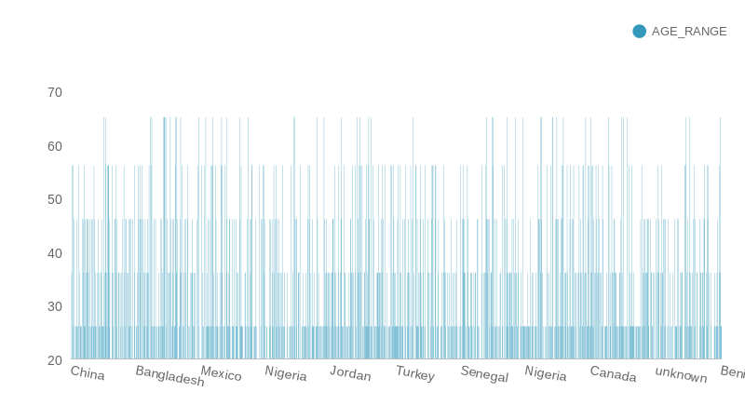
Part 2 Student Demographics—— Di Nie
Student’s age range in different countries
We have listed a number of countries to show the age distribution of students, with the largest proportion of students over 20 and under 30 years old.

Slide 9
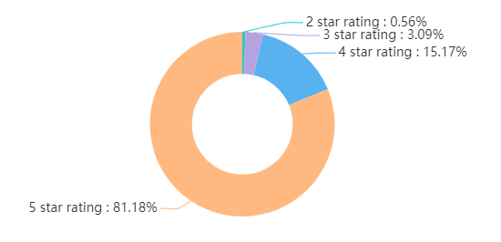
Part 3 Course Feedback—— Ziming Bai
Overall speaking: 5 star rating comments dominate the whole comment situation.
The course was highly rated by the audience

Slide 10
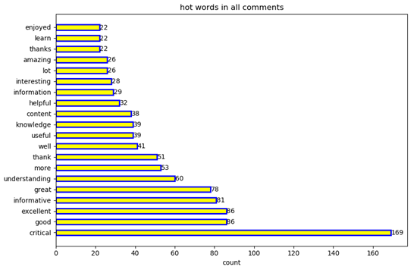
Part 3 Insights
The statistics for all comments:
The ‘critical’ is the most frequently mentioned word, mainly about some critical cases
Notes:
Here are the 20 most frequently used and meaningful words in comments

Slide 11

Part 3 Insights
As we can see, almost all the comments were positive
The audience expressed their praise and thanks, as well as the richness and interest of the course
Notes:
I believe these statistics will certainly promote the publicity and improvement of the course.

Slide 12
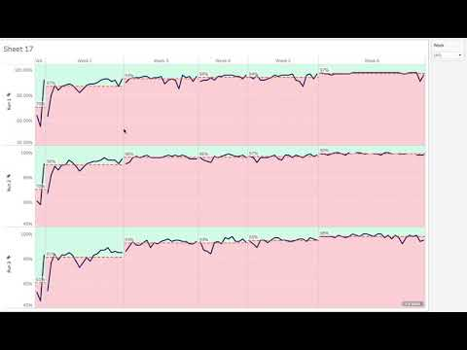
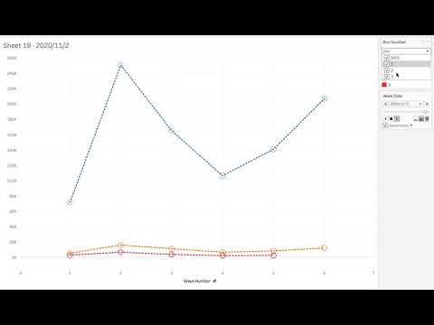
Part 4 Enrolments Data—— Xi Pang
A line chart shows how step completion rates change as students go through this course.
A dynamic line chart shows how visitor counts change as time goes by.

Slide 13
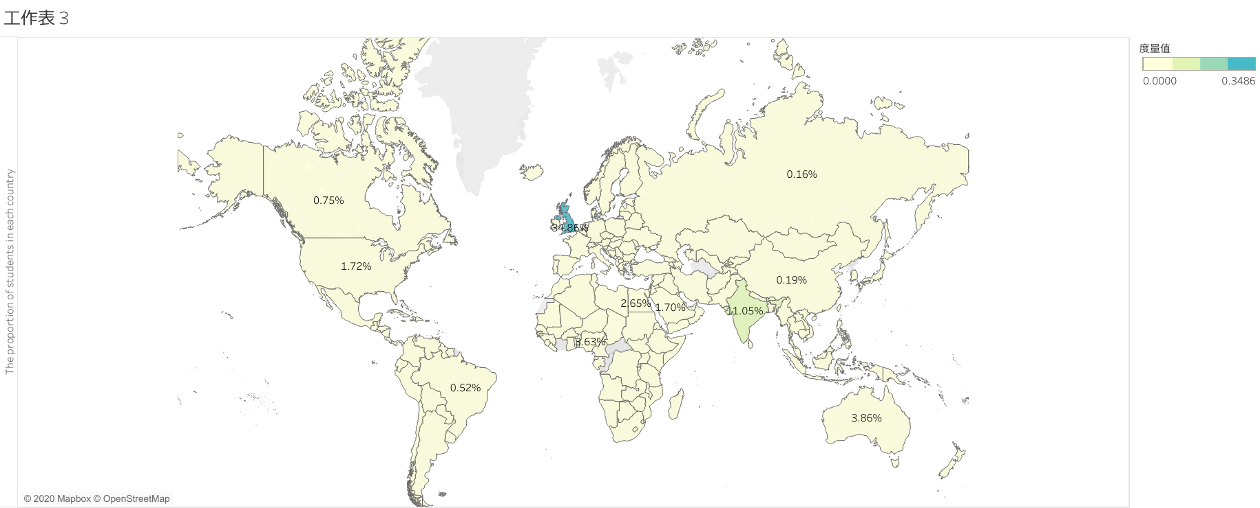
Part 2 Student Demographics—— Di Nie
The proportion of students in each country
34.86% of registered students are from the UK, which is the place with the highest number of registered students, followed by India, Australia and so on

